Slide 1

The Battle of Neighborhoods Applied Data Science Capstone Project
Determining the distribution of Italian restaurants in Chennai to Identify the best locality to start a new one
by: Venkatesan N

Slide 2
Introduction
Background
To identify the best locality in Chennai to start a Italian cuisine restaurant.
Problem Description
Chennai is a city which home for some of the most delicious foods in southern india. A wide variety of cuisines are consumed in Chennai.
Being a metro city home to people from multiple cultures it is important to have multiple cuisines in Chennai.
Apart from the local cuisines, the most sought after cuisines are Italian and Chinese. In this project we try to identify the distribution of Italian restaurants in different localities
Interest
Those who are interested in starting an Italian restaurant in Chennai.

Slide 3
Data Acquisition and Processing
Data Terminology
In India, restaurants usually serve multiple cuisines. Also, Most of European cuisine is marked as Italian cuisine. German/ Spanish(Such as Paella) cuisines are not specifically served and they are included in Italian cuisine.
Data Sources: 3 types identified
Venue data from Foursquare.com
Names of localities are taken from https://en.wikipedia.org/wiki/Areas_of_Chennai.
Location data is taken from geocoder library from Google
Data cleaning
Foursquare takes a lat/long, a radius, and attempts to retrieve the specified number of venues covered by the circle scribed by the radius. Small radius means insufficient venues retrieved. Large radius means overlapping circles and duplicate venues
Food Venue Category- venues are classified rather arbitrary

Slide 4
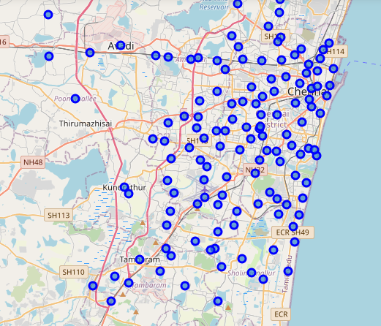
Chennai Localities map

Slide 5
Data Acquisition and Processing (cont.)
Feature selection
Chennai has about 150+ neighborhoods. Group by neighborhoods
Foursquare will retrieve firstly by food, then by Italian food
Analytical method – Demand and Supply of the market segment
The classification of “Italian Restaurant” in India is a very broad classification. It includes food from Spanish and German Cuisines too. Most Italian Restaurants encompasses food from many European countries.
The reason for choosing Italian is, it is the most famous than cuisine after Indian (which comprises north indian and south Indian)
It is a popular belief that central & south Chennai (considered economically richer suburbs) has more Italian options.
The data distribution of class of people locality wise is not available and hence I will use the local knowledge to summarise the findings.

Slide 6
Exploratory Data Analysis - Demographics
Given the size of the city is very huge, the distribution of class of people is divense.
- generally speaking, the localities shown within in the circle in the adjacent figure is considered to be where wealthier people reside.
This also has to do with proximity to beaches & entertainment avenues. Localities closer to the beach (adyar, Mylapore, Triplicane, Thiruvanmiyur, besant nagar etc) are composed of wealthier people
Further away towards the west is the industrial zones of Chennai where the wealth distribution is much lower
Wealth distribution is an important factor for people to try different cuisines.

Slide 7
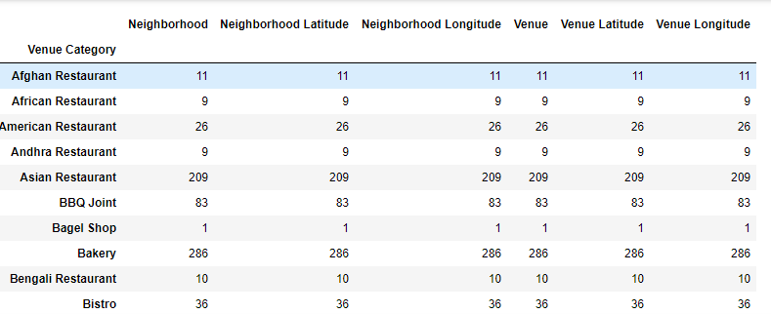
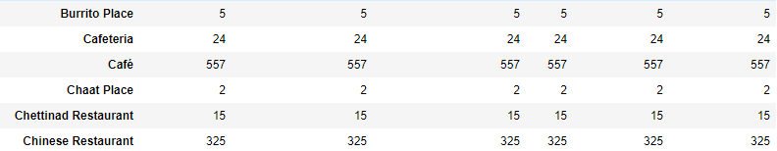
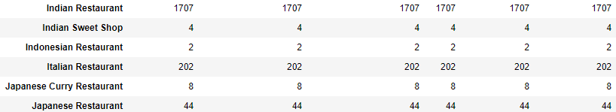
Exploratory Data Analysis – Demographics (cont)
The table on the right shows part of the overall dataframe imported from foursquare
It shows the distribution of different cuisines of restaurants in Chennai, not considering which locality.
Although, not all categories are shown here, the major cuisines are shown here.
Among the majors cuisines, apart indian, the next most opted for cuisines are Asian, Chinese and Italian.
The spread of Italian cuisines is shown in the next slides.

Slide 8
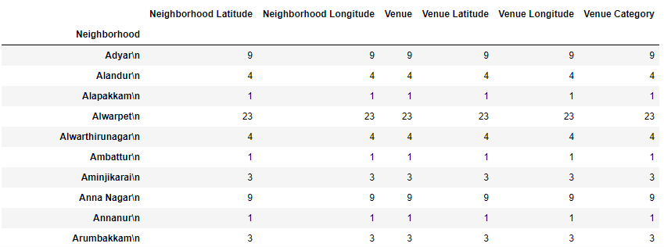
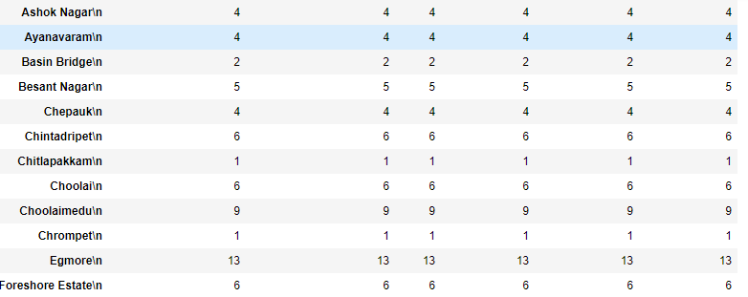
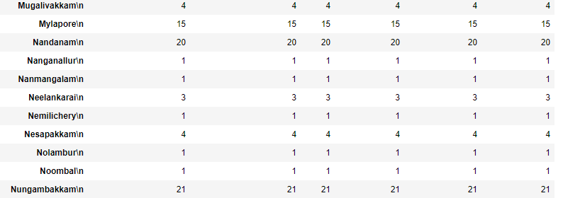
Exploratory Data Analysis –Foursquare (cont.)
The table on the right shows a part of dataframe used in the analysis.
In this dataframe it can be seen that upscale areas such as Anna Nagar, Alwarpet, Adyar, Egmore, Mylapore, Nungambakkam etc have more Italian places.
This s due to the those areas considered to be commercial hubs and upmarket residential places.
Egmore, Nungambakkam & alwarpet are the most common commercial destinations owing to a lot of entertainment avenues nearby which makes it most common place for Italian restaurants.
Anna nagar, Mylapore and Adyar are the residential hubs which makes them ideal places too

Slide 9
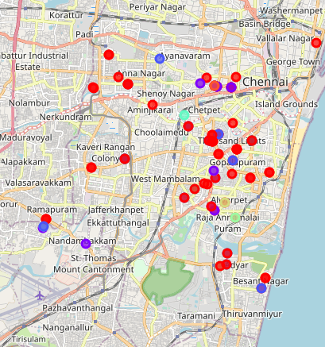
Interpreting the results
Considering the earlier explanation of commercial hubs and upmarket residential places and looking at the distribution of Italian restaurants in the map shown,
Most of Italian restaurants are concentrated in the central part of Chennai
As we more westward toward the industrial areas, the density of Italian is lower
Also, the availability of Italian food in southern part (Along OMR and ECR) which is considered the IT hub it is clear that there is no Italian restaurant.
Considering the fact that, many people consuming the cuisine are living along OMR and ECR a good Italian restaurant situated anywhere along OMR will see good footfalls.
As a second option, a good restaurant near Mambalam/ Kodambakkam is also expected to good footfalls due to a lack of good itlaian places in the vicinity

Slide 10
The End

